Slide 1
Testable, ES2015, AngularJS 1.5.x Component Based Applications
Karl Shifflett
https://oceanware.wordpress.com/
@kdawg02

Slide 2
Agenda
Application Demo
Architecture and Language Choices
Testing Choices
Transpiling at Run-Time, Test-Time, and Build-Time
AngularJS 1.5x

Slide 3

Application Demo
npm run mocha
npm run start
Wrote this application using the Atom editor.
I have provided my Atom editor code snippets.

Slide 4
Architecture and Language Choices
So many options for building Angular applications today.
Choice is a good thing.

Slide 5
High Level Options
Our Application
AngularJS 1.5.x - Components
ES2015 (ES6)
jspm – package manager, bundler, transpiler
System.js – module loader
Bootstraps differently
Why choose this stack to build on?
Alternate Choice(s)
AngularJS 1.5.x - Components
ES5, TypeScript, or ES2015 (ES6) – JavaScript
If required use transpiler
Use index.html and script tags
Typical AngularJS Bootstrapping

Slide 6
Bootstrapping
Index.html
loads System.js, config.js, and bootstrap.js
bootstrap.js
Loads angular and ngComponentRouter
Loads angular modules: app and review
Creates angular module, main
Invokes the angular bootstrapper
Angular modules
Load and register components, directives, and services
Configure routing

Slide 7
Walkthrough Application Code
Pay Attention To:
Project structure
Components and single responsibility controllers
Clean code (thanks to ES6!)

Slide 8
Testing Choices
Perform deep spiking on all architecture, language, and testing choices before starting a large project.

Slide 9
Mocha, Chai, Sinon, Karma
Mocha is a Nodejs JavaScript test framework
For unit tests that do not require Angular to be loaded
Chai is a BDD/TDD assert library
Sinon standalone test spies, stubs, and mocks
Karma test runner written by AngularJS Team
For integration tests (will add these at a later date)
Mocha configuration and running mocha
package.json, test folder files (_mocha not mocha)

Slide 10
Transpiling at Run-Time, Test-Time, and Build-Time
Full ES6 support across browsers is still lacking.
Transpilers like Babel or traceur transpile ES6 to ES5.

Slide 11
Run-Time Transpiling
jspm transpiles ES6 to ES5 on the fly
Supports ES7 Decorators and Class Properties
Run-time demo using Chrome Developer Tools
package.json and config.js

Slide 12
Test-Time Transpiling
Babel 6 transpiles ES6 to ES5 on the fly passes to mocha
Supports ES7 Decorators and Class Properties
Test-time demo
package.json, mocha.opts, and .bablerc
Notice the tools and transpilers are different between run-time and test-time.
When System.js 0.17 RTM’s this will change.

Slide 13
Build-Time Transpiling
jspm provides outstanding bundling features
Self-executing bundle transpiles all ES6 modules and dependencies and bundles them into a single JavaScript file.
Self-executing bundles are small which load very fast in a single http request.
In the near future, I will add a gulp build task to this project that will perform bundling and minification.

Slide 14
AngularJS 1.5.x
Components greatly simplify writing directives.
Angular 2 and Aurelia use component architectures.
Learning and deploying today will prepare you for tomorrow.

Slide 15
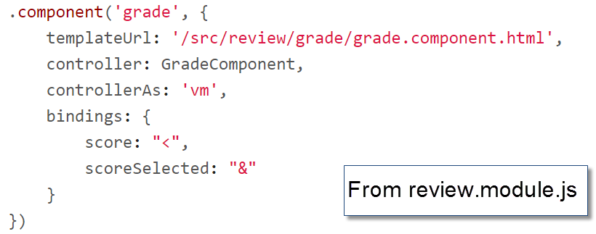
Component Registration
When unit testing, you may want to register your components differently. There are several valid strategies.
Why this strategy?

Slide 16


Component Tree
index.html
Root
Review
List
Detail
Grade
Home

